Slide 1

Standard (or Primary) Views
Orthographic Multiview Projections

Slide 2
At the end of this lecture you will be able to:
Define Orthographic Multiview Projections.
Define the two projection systems most commonly used.
Identify necessary views.
Orient parts in orthographic multiview projections.
Define dimensions shown in the different primary views.

Slide 3
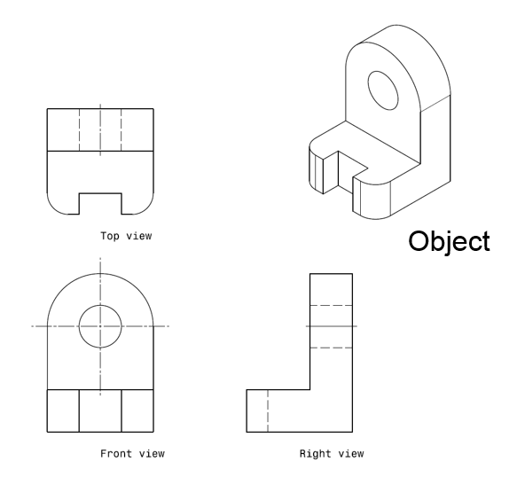
Well, what are Orthographic Multiview Projections?
Orthographic multiview projections are geometric representations of the faces of an object showing visible and invisible edges.
Three orthographic multiview projections of the object shown on the left are projected and arranged in the form of a two-dimensional drawing. These views are labeled front, top and right views.

Slide 4
Projection Systems
There are two main systems used for projecting the views:
The third-angle projection system
and
The first-angle projection system
You should understand both methods. However, in this course, we will only use the third angle projection system.

Slide 5
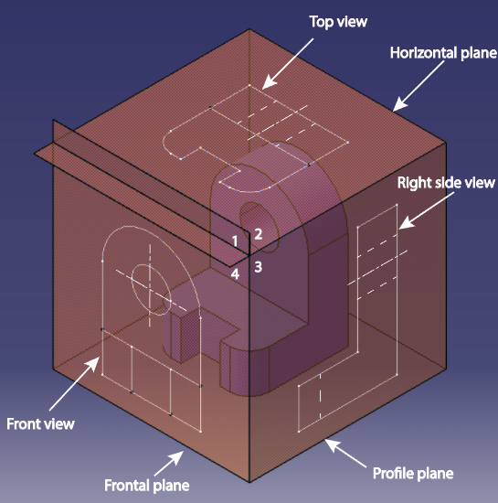
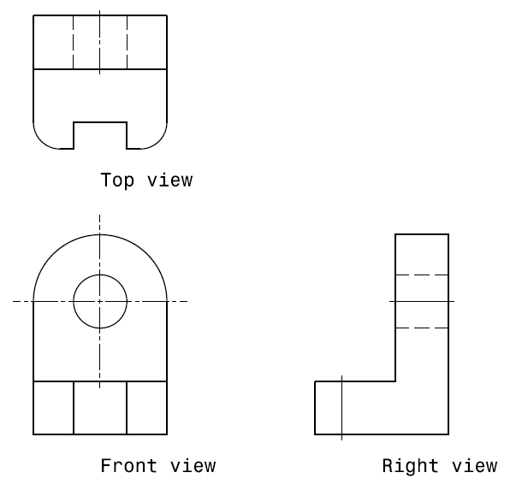
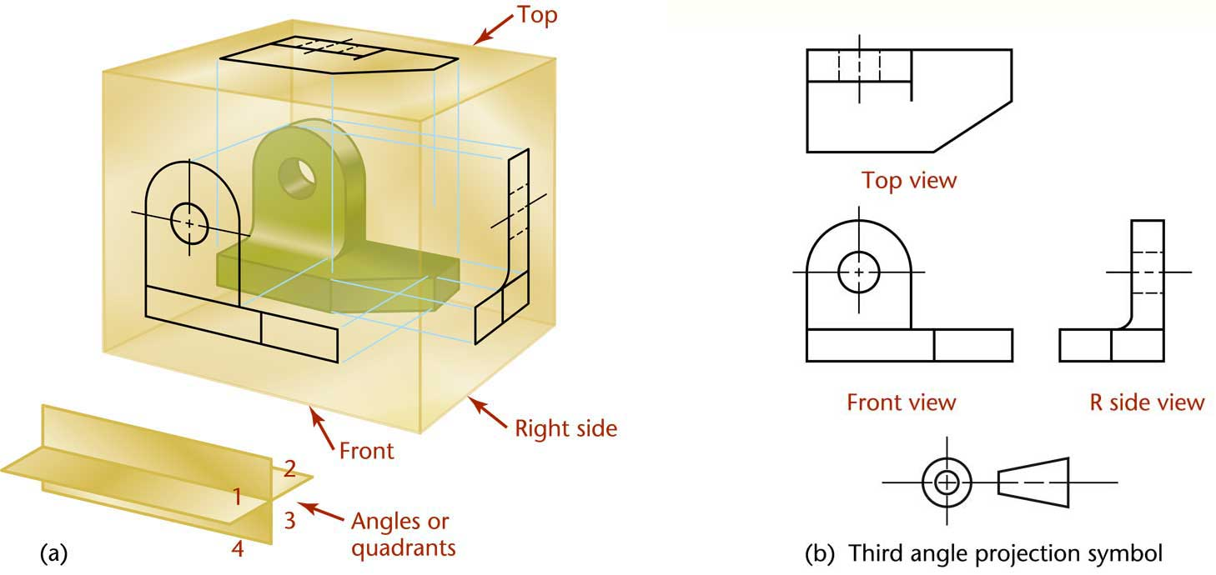
Parallel Projections: Third Angle Orthographic Multiview Projections
In the third angle projection system, the object sits in a box placed in the third quadrant of the coordinate system shown above. The front view projects on the frontal plane, the top view projects on the horizontal plane, and the right side view projects on the profile plane. The views are arranged as shown to the right, and the third angle projection symbol is added to alert the reader that this form of projection is being used.

Slide 6
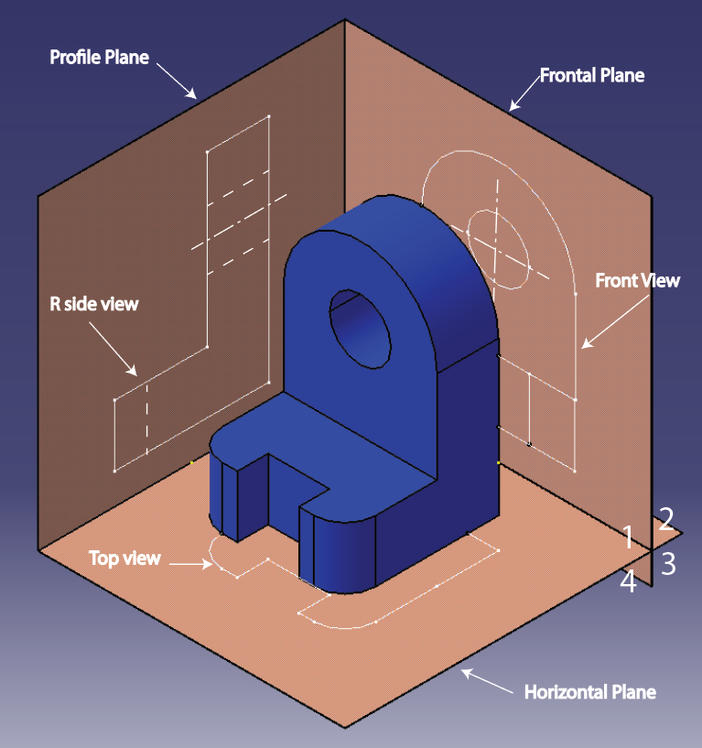
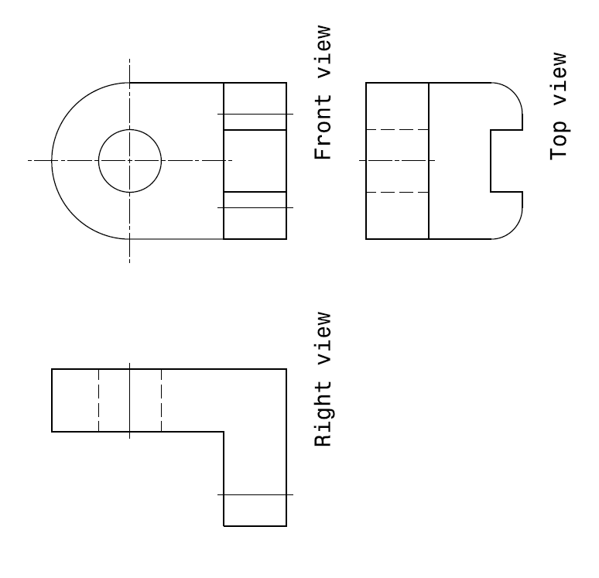
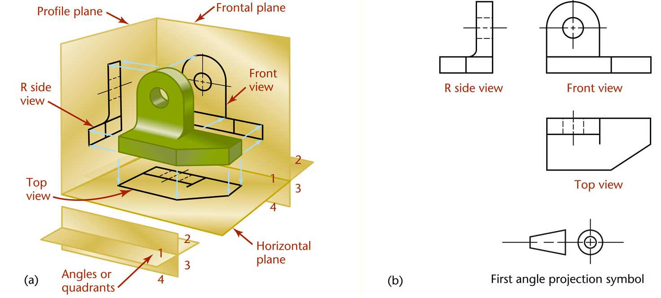
Parallel Projections: First Angle Orthographic Multiview Projections
In the first angle projection system, front, top and right side views are still projected on the frontal, horizontal and profile planes, respectively. However, the object is placed in the first quadrant of the coordinate system shown above. This makes the top view appear at the bottom of the front view, and the right side view appear at the left of the front view. The first angle projection symbol is added to the drawing to alert the reader that this projection system is being used.

Slide 7
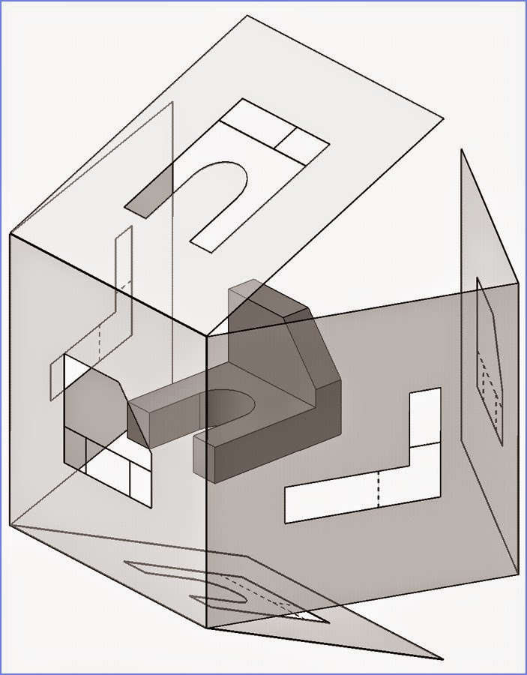
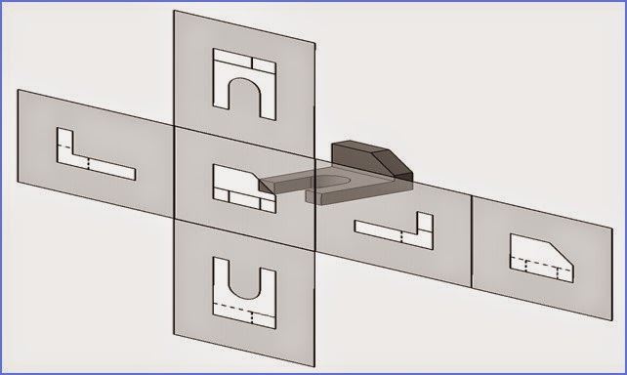
Orthographic Multivews Projections: Summary
This slide, subsequent slides in this presentation, and the other presentations in this course are for third angle projections. There are 6 standard or primary views; one for each face in the projection box illustrated above. For each view, the line of sight is perpendicular to one of the primary planes of projection. It is also possible to have other lines of sight. The views corresponding to lines of sight that are not parallel to any primary plane of projection are called auxiliary views. If views show internal features visible (after hatching), the views are called section views.

Slide 8
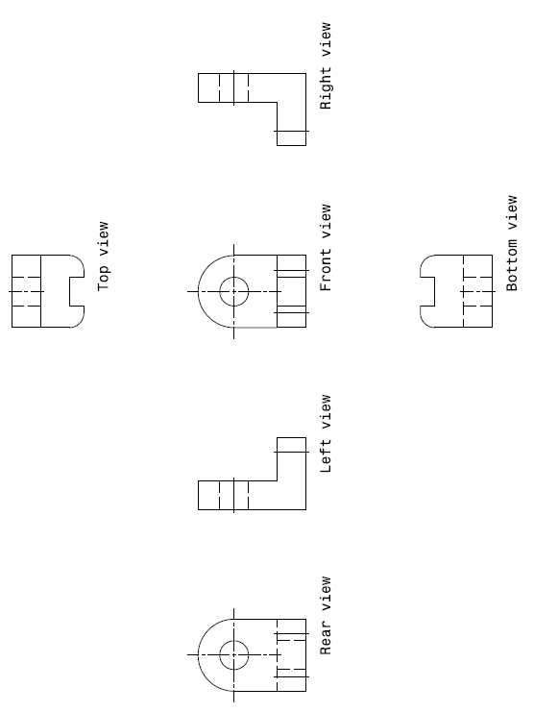
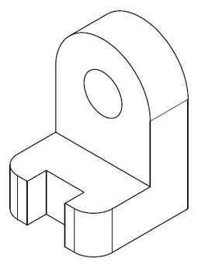
Necessary Views
A set of orthographic multiview projections should only include the views necessary to:
Show all the profiles of an object defining its basic geometry.
Show all object features visible on at least one view.
X
X
X
For instance, for the object shown here, three profiles define it: The dome visible from the front, the L-shape visible from the right side, and the C-shape visible from the top. The hole is also visible from the front side. Hence, three views, front, top and right side are necessary and sufficient. The rear, bottom and left side views are not necessary, and are not to be drawn.

Slide 9
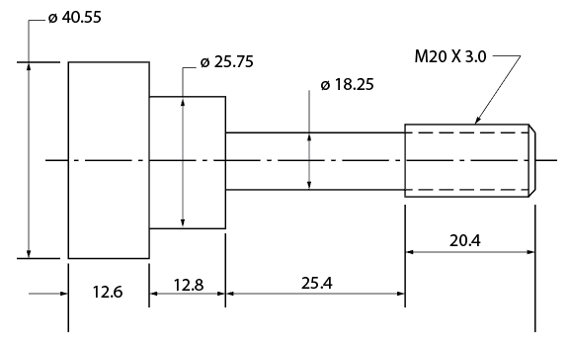
Necessary Views
The shaft shown above has circular symmetry (as specified by the symmetry/center line in the view.) Hence, only one view is necessary and sufficient. Shafts of circular cross section usually need only one view.

Slide 10
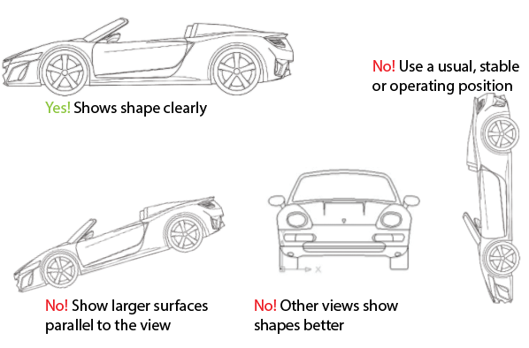
Orientation of the Front View
In drawings, objects should be oriented the way they typically work as a stand-alone unit, or in an assembly. A car, for instance, usually appears as in the drawing labeled “Yes!”, and not as in the drawings labeled “No!”.

Slide 11
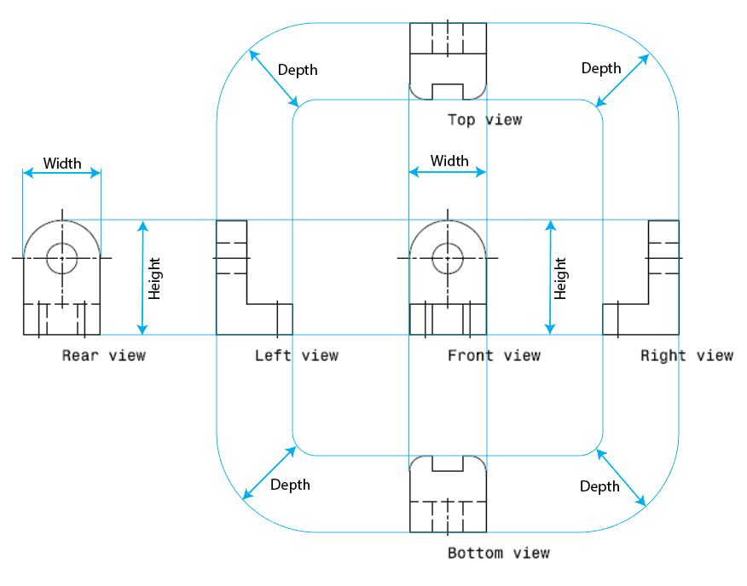
Principal Dimensions
Any principal view shows two of the three principal dimensions:
Height is shown in the rear, left-side, front, and right-side views.
Width is shown in the rear, top, front, and bottom views.
Depth is shown in the left-side, top, right-side, and bottom views.

Slide 12
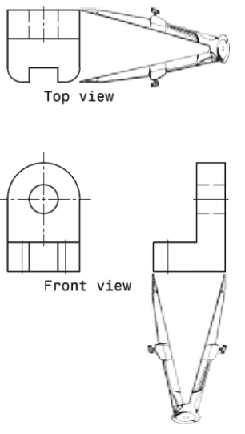
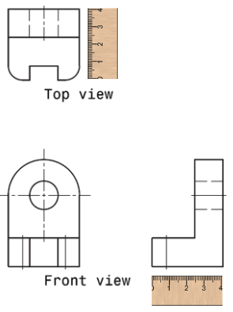
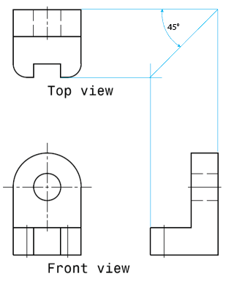
Principal Dimensions
1) Dividers
2) Scales
3) Miter line
The principal dimensions in the views must correspond to each other, as illustrated above. For hand sketching, a miter line (the 45° line on the drawing to the right) provides a convenient way to make sure that dimensions in different views match each other.

